Slide 1
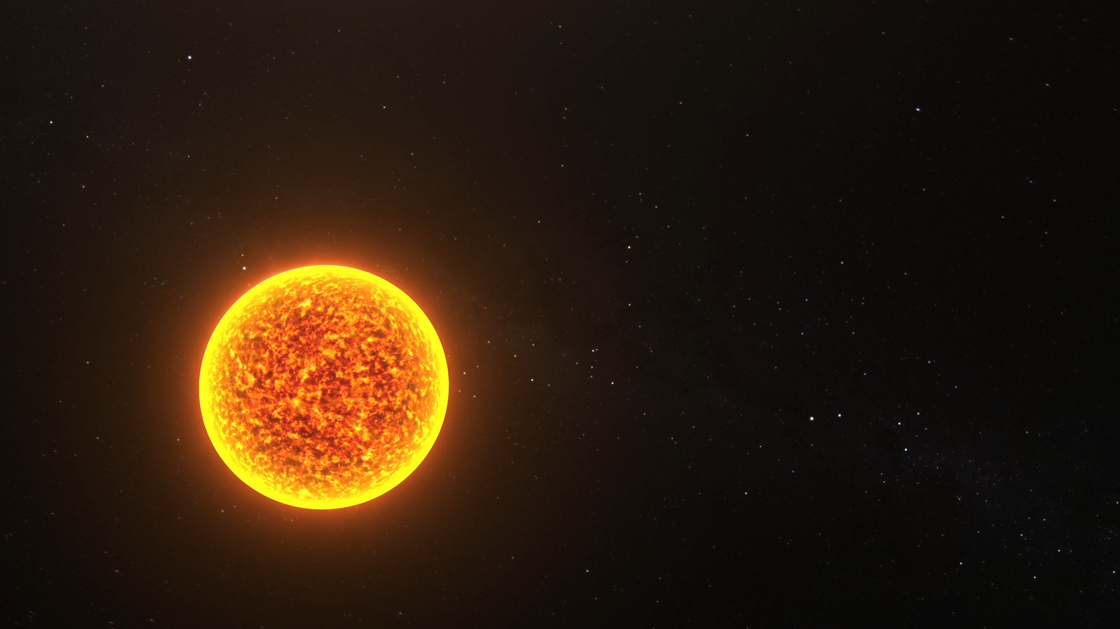

Slide 2
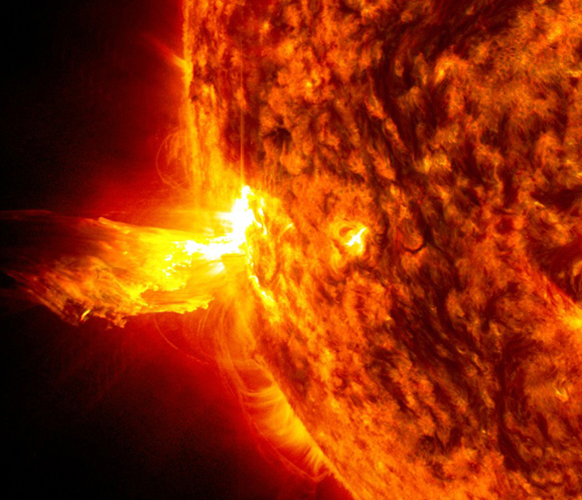
Edens Zero
Bhavya Gudhka
Arpan Charkraborty
Man Gudhka
Bhavya Nirmal

Slide 3
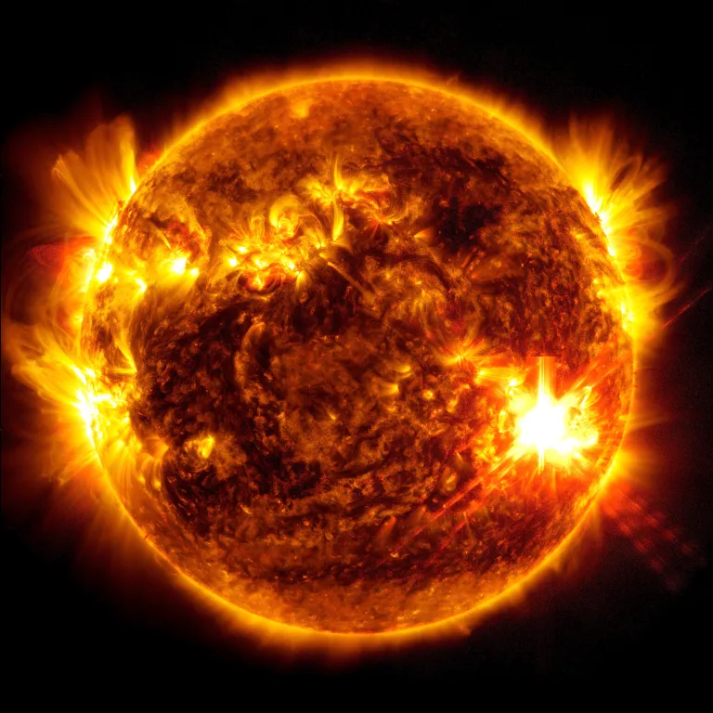
Although the Sun is 93 million miles away from our planet, solar activity can significantly impact our daily lives. “Space weather”—the variations that occur in the space environment between the Sun and Earth—can impact technologies in space and on Earth.

Slide 4
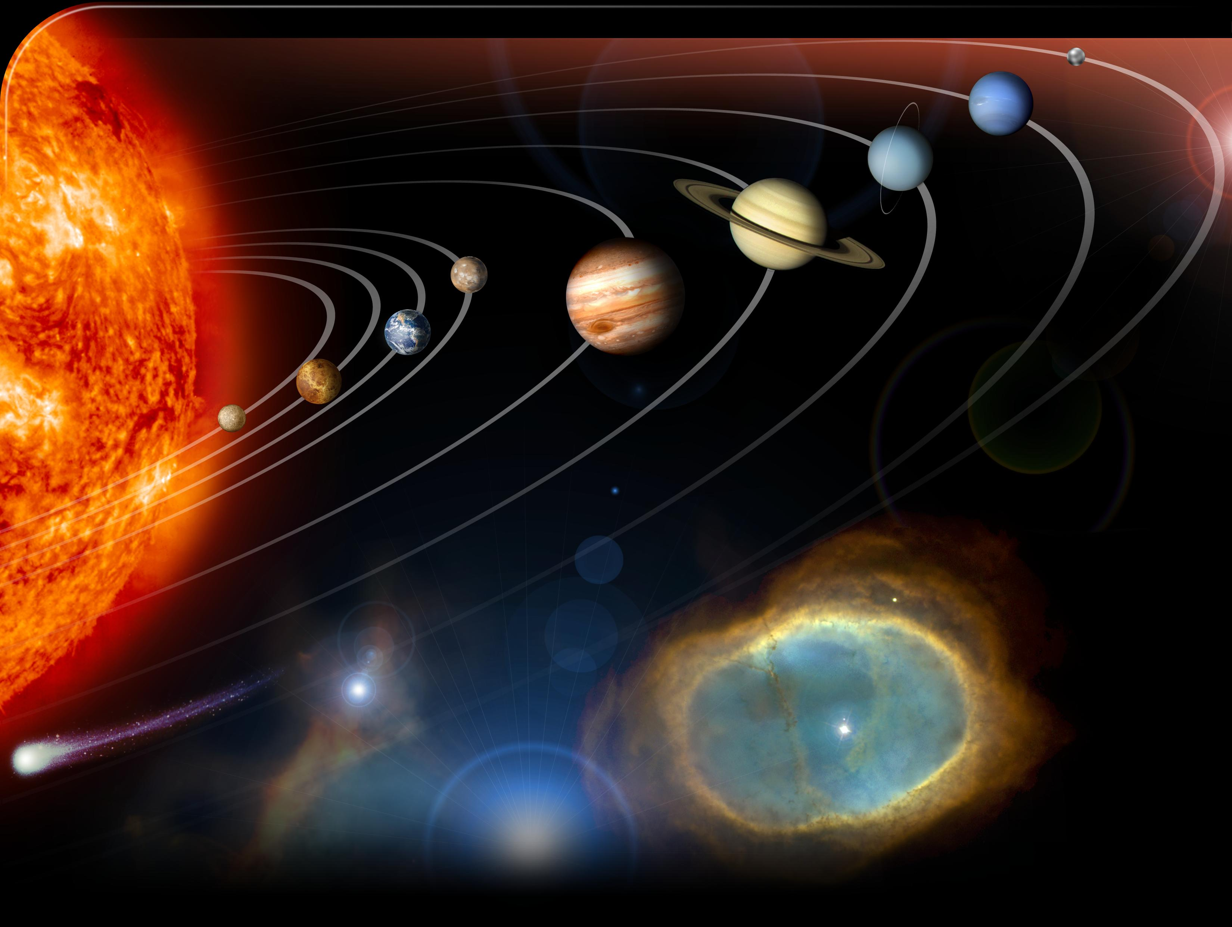
What is Space Weather?
Space weather refers to the environmental conditions in space caused by the Sun’s activity—such as solar flares, solar wind, and coronal mass ejections (CMEs)—that can affect:
Earth’s magnetosphere
Satellites
Astronauts
Radio and GPS signals
Power grids on Earth

Slide 5
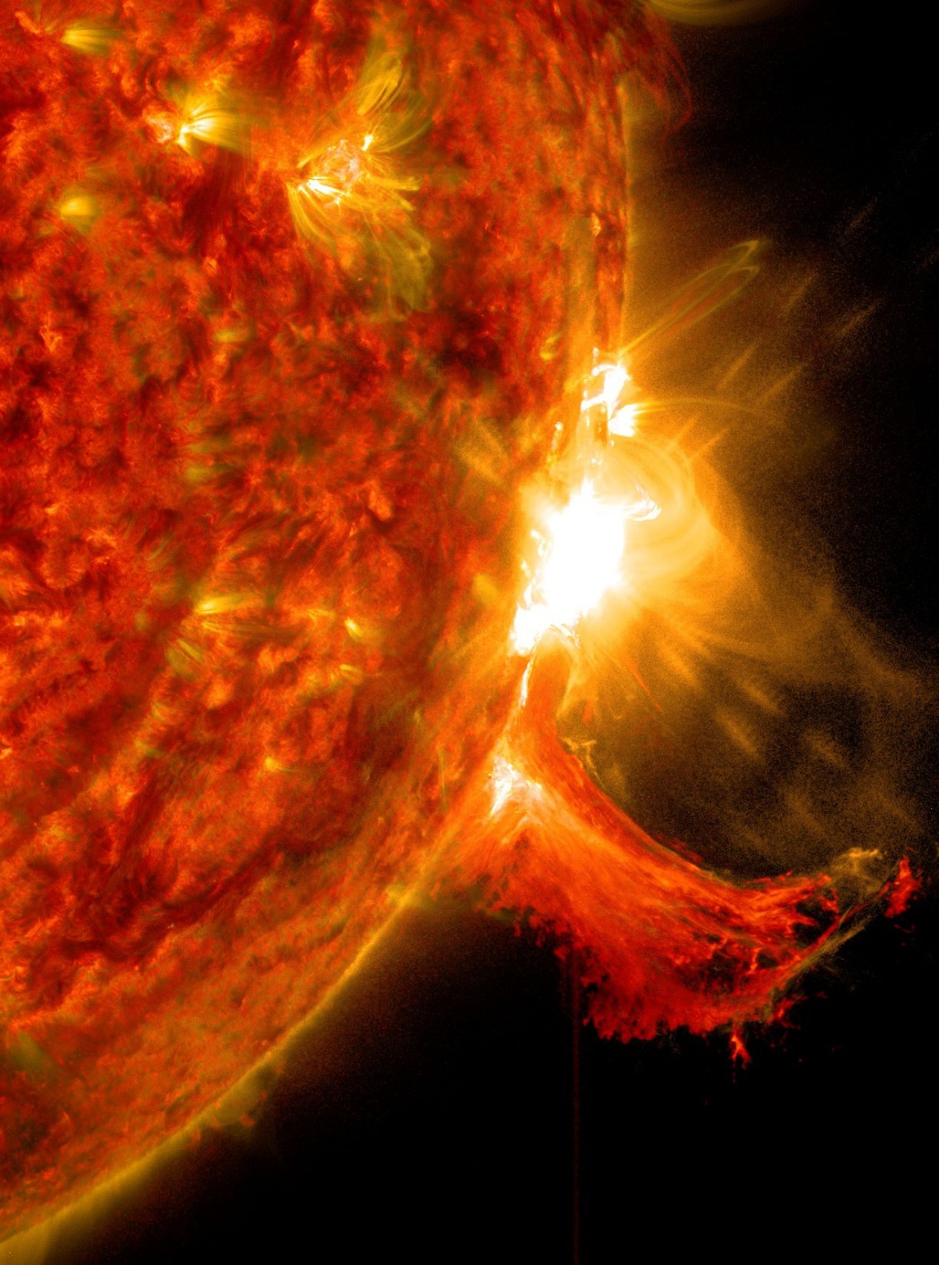
What is a Solar Flares?
A solar flare is a sudden, intense burst of energy from the Sun’s surface, caused by the release of magnetic energy stored in the Sun’s atmosphere.
They are categorized by intensity using letters:
A, B, C – Weak
M – Moderate
X – Strong (with potential for serious impacts on Earth)

Slide 6
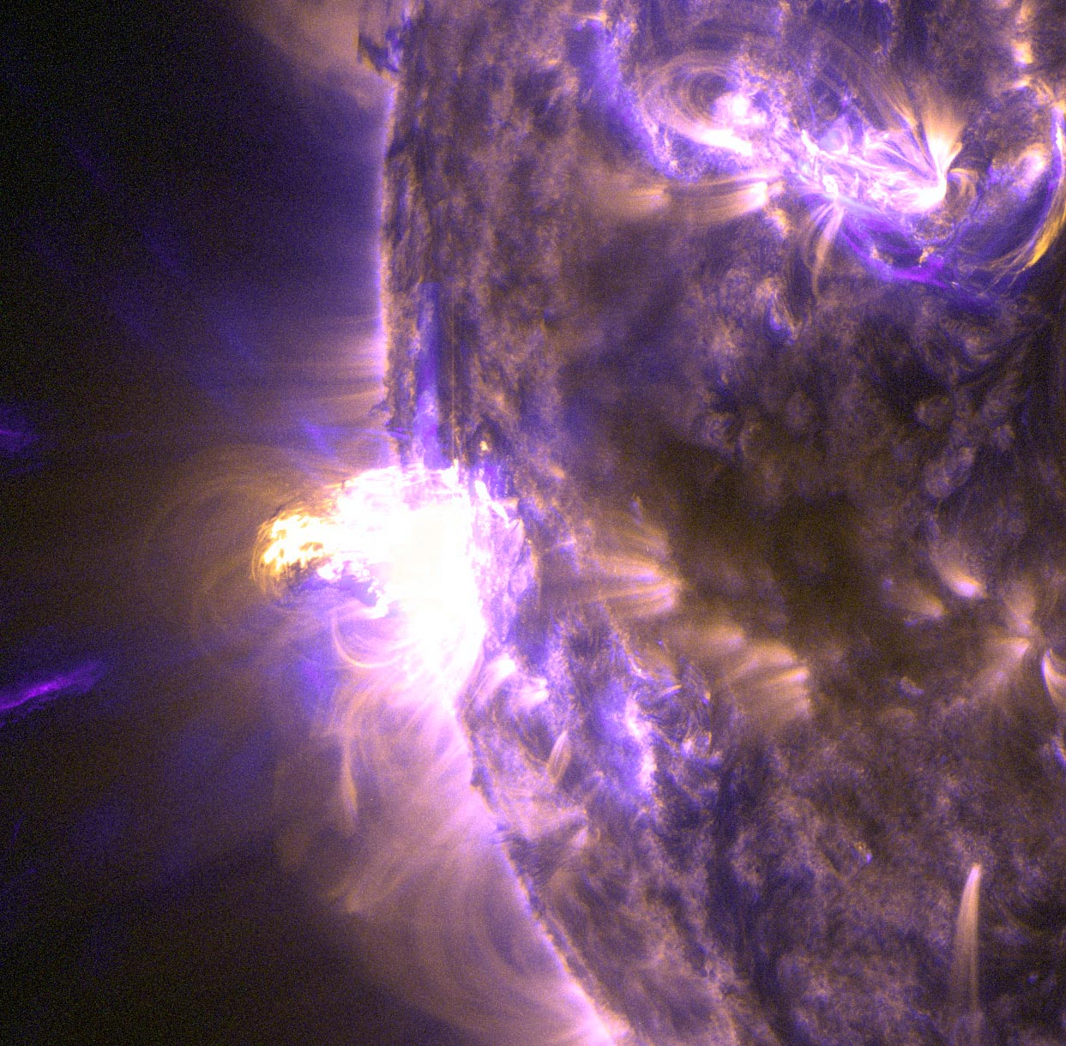
Effects of Solar Flares:
Radio Blackouts: Disrupts high-frequency (HF) radio communication.
Navigation Issues: Interferes with GPS signals.
Radiation Hazards: Increases radiation exposure for astronauts and high-altitude flights.
Auroras: Sometimes linked with auroras when combined with other solar events.

Slide 7
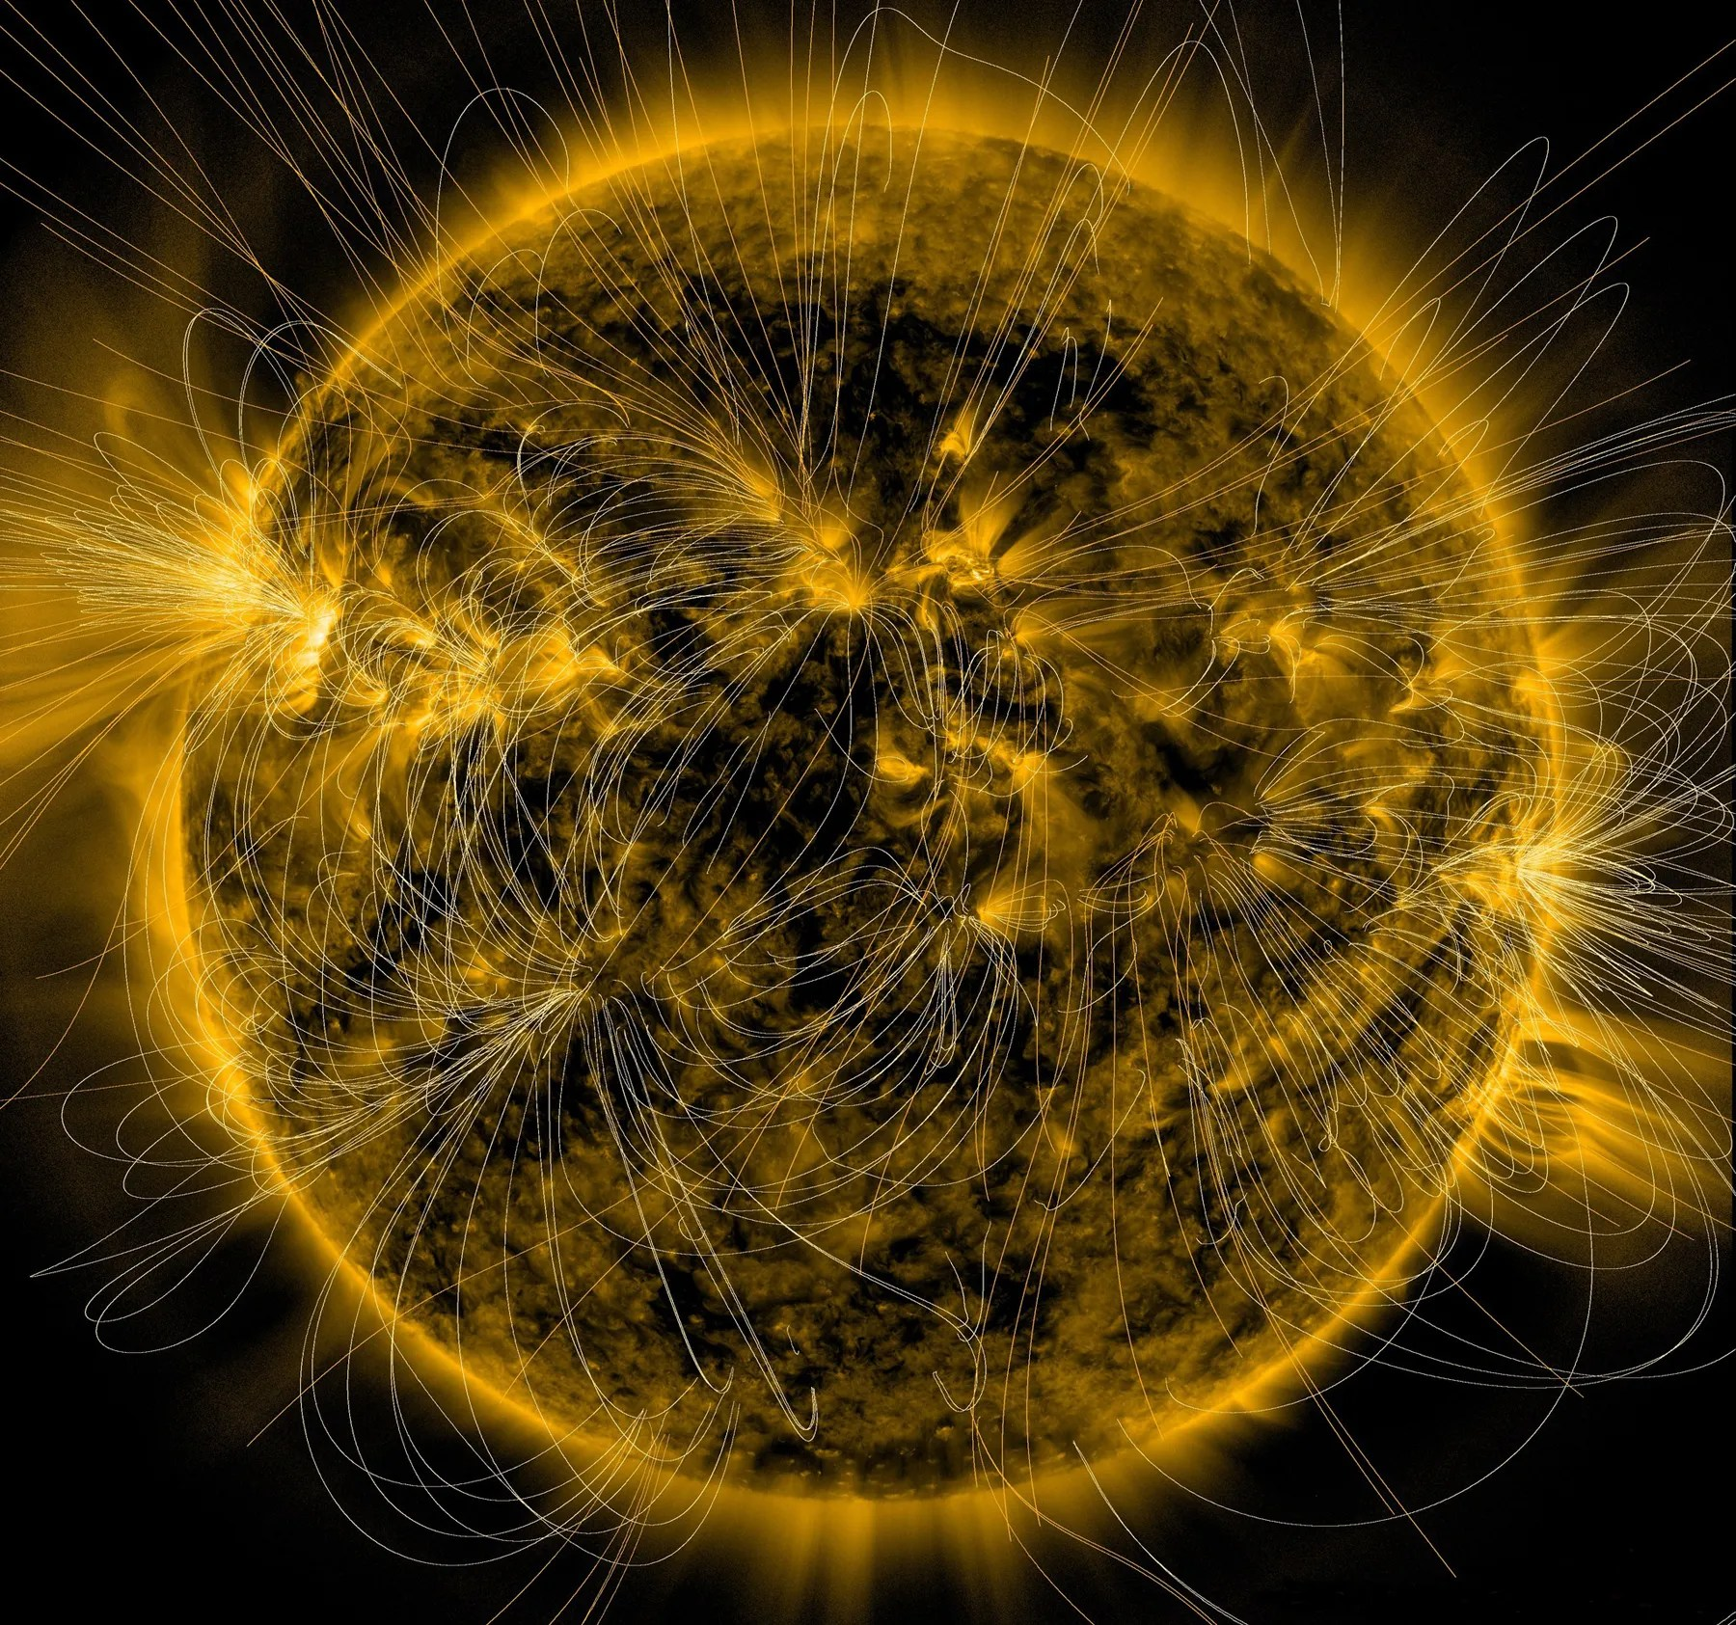
Precautions:
1. Monitoring and Alerts
Use Alerts from:
NOAA's Space Weather Prediction Center (SWPC)
NASA’s Solar Dynamics Observatory (SDO)
Install Apps or Subscribe to Alerts:
Use apps/websites that provide real-time solar flare and geomagnetic storm alerts.

Slide 8
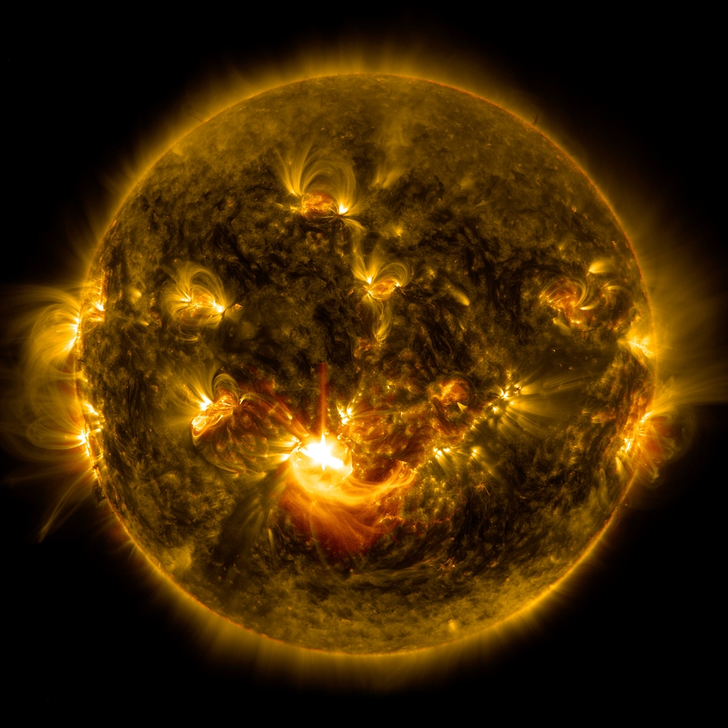
2. General Public and Technology Use
Unplug Electronics:
During severe geomagnetic storms, unplug sensitive electronics to prevent damage from surges.
Emergency Preparedness:
Keep emergency supplies (water, food, flashlight, radio) in case of prolonged outages.
Stay Informed:
Follow space weather alerts from agencies like NOAA, NASA, or local weather services.

Slide 9

3. Power and Electrical Infrastructure
Power Grid Management:
Utility companies may reduce load or reconfigure systems to prevent large-scale blackouts.
Isolate transformers and critical components from geomagnetically induced currents (GICs).
Backup Power Systems:
Ensure essential services (e.g., hospitals, emergency centers) have functioning backup generators.
4. Astronaut Safety (Space Missions)
Move to Shielded Areas:
Astronauts aboard the ISS move to better-protected parts of the station.
Delay Spacewalks:
Postpone EVAs (extravehicular activities) until the radiation risk is lower.

Slide 10
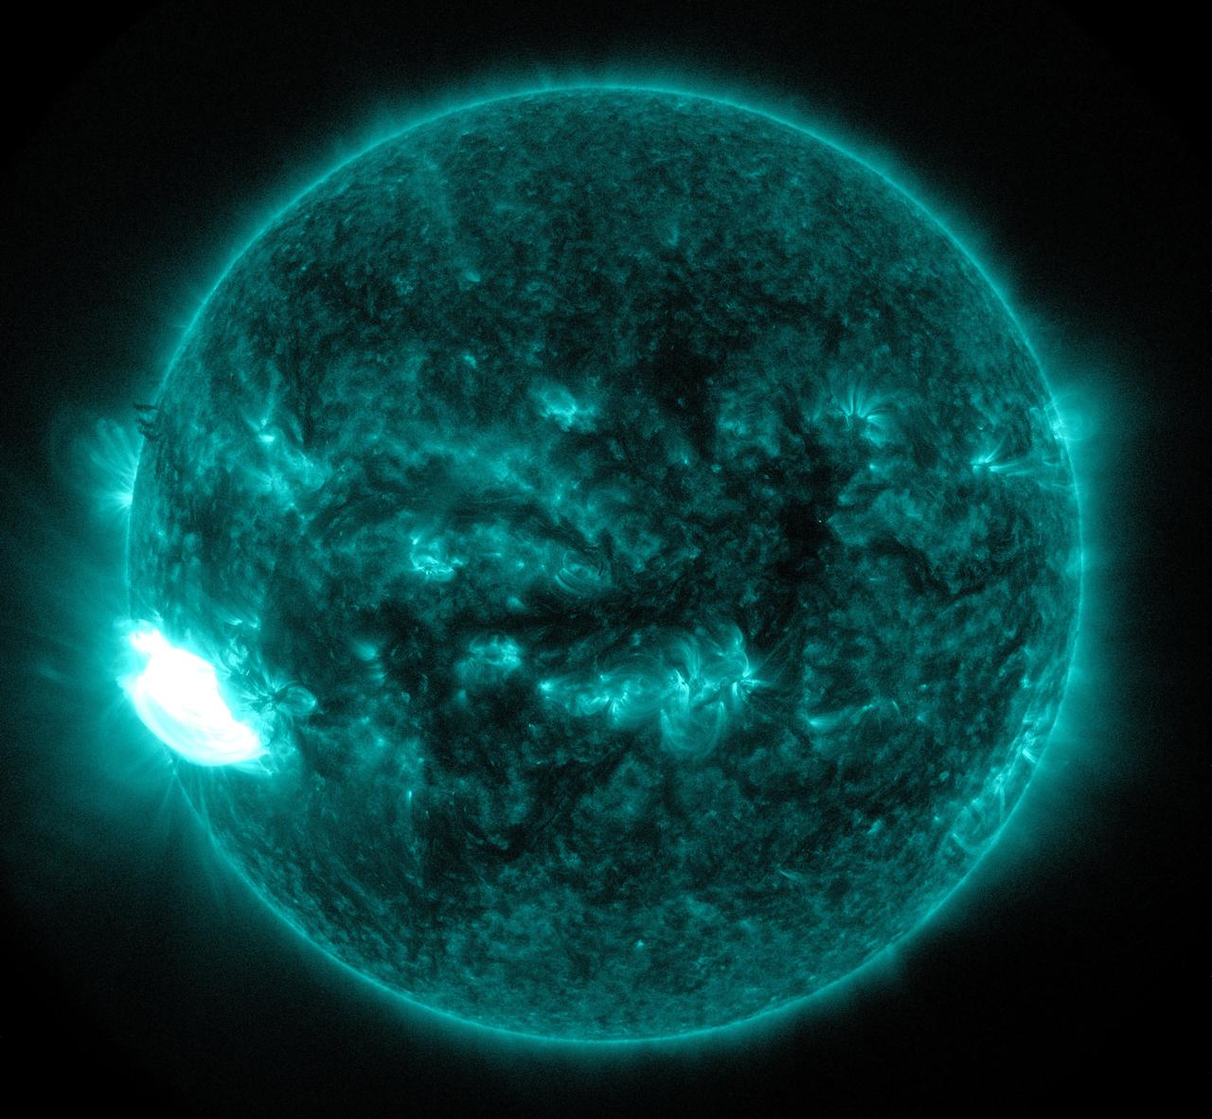
5. Satellites and Spacecraft
Switch to Safe Mode:
Space agencies (like NASA) may put satellites into safe mode to protect electronics.
Delay Satellite Launches:
Avoid launching during solar storm warnings.
Shielding:
Use radiation shielding to protect satellite electronics.
6. Communication and Navigation
Limit High-Frequency (HF) Communication:
Airlines and military may avoid HF radio during intense solar activity.
Alternative Communication:
Use satellite phones or ground-based communication when GPS is disrupted.
Avoid Dependence on GPS:
Use traditional navigation methods (maps, compasses) as backups.

